Slide 1
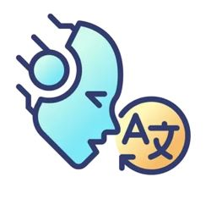


SPEAKEZ
AI Language Translator
Kaali Lovell | Pavan Polireddy | Rakesh Tirumala
Steve St Fleur | Tanvi Prakash Gavali | Venkat Sai Pallapu

Slide 2

AGENDA
1- Sprint 0 Recap | 2- Project Overview | 3- Backlogs | 4- Team Metrics | 5- Product
Team Roles & Responsibilities Improvements Project Description Team Working Agreement Personas | MVP Languages & Tools Algorithms Diagrams Sprint 1 Recap | Product Backlog Sprint 2 Backlog Test Cases Story Completion | Team Velocity Burndown Charts Retrospective | Sprint 3 Stories Application Screenshots API Live Application Demo

Slide 3

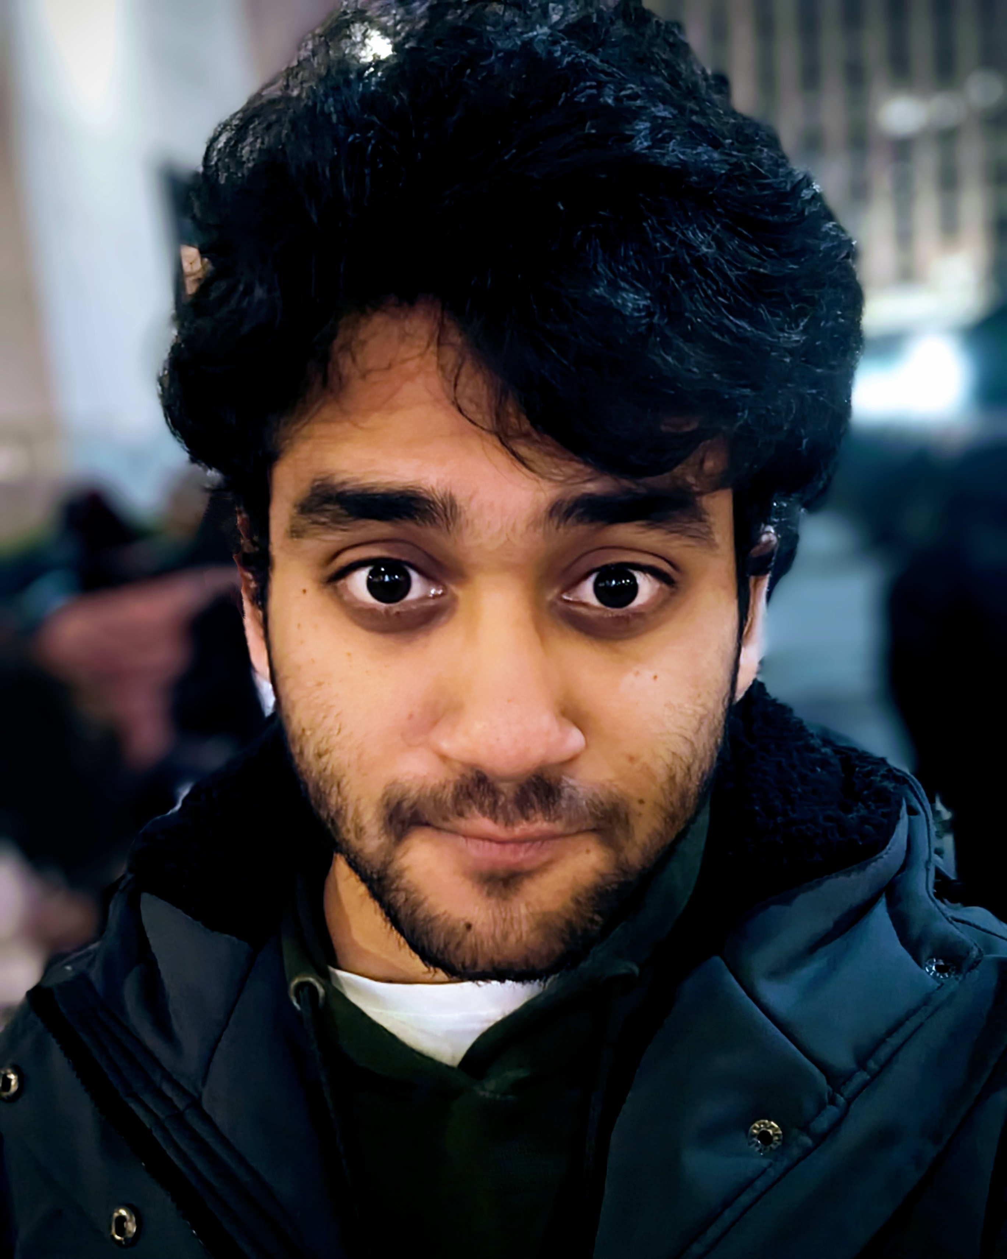
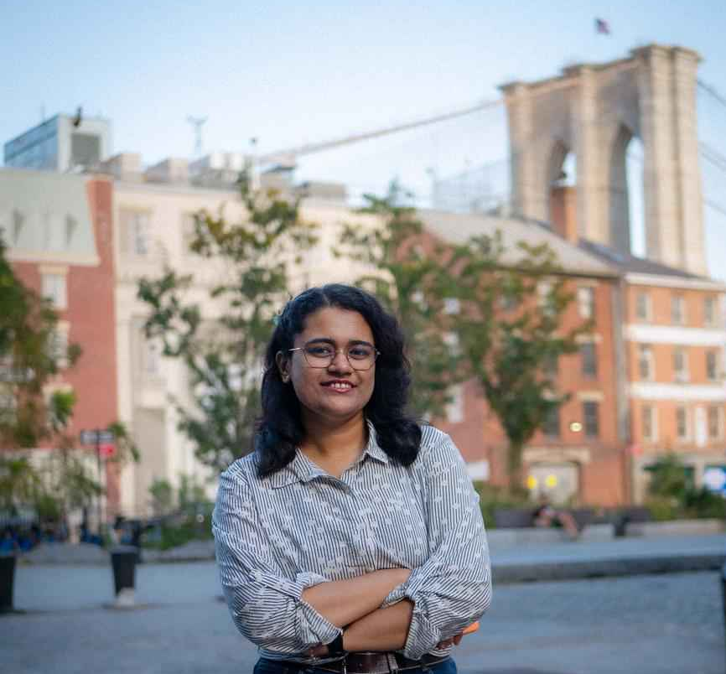
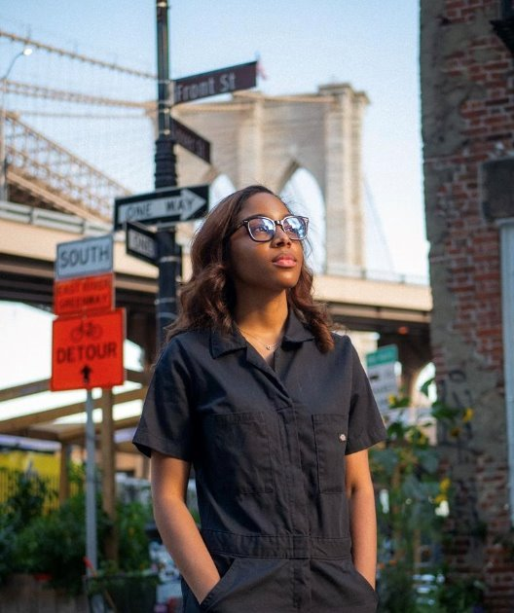
TEAM ROLE & RESPONSIBILITIES
Rakesh Tirumala
Team Lead/ Developer
Tanvi Prakash Gavali
Scrum Master/ Developer
Kaali Lovell​
Tester/ Product Designer

Slide 4
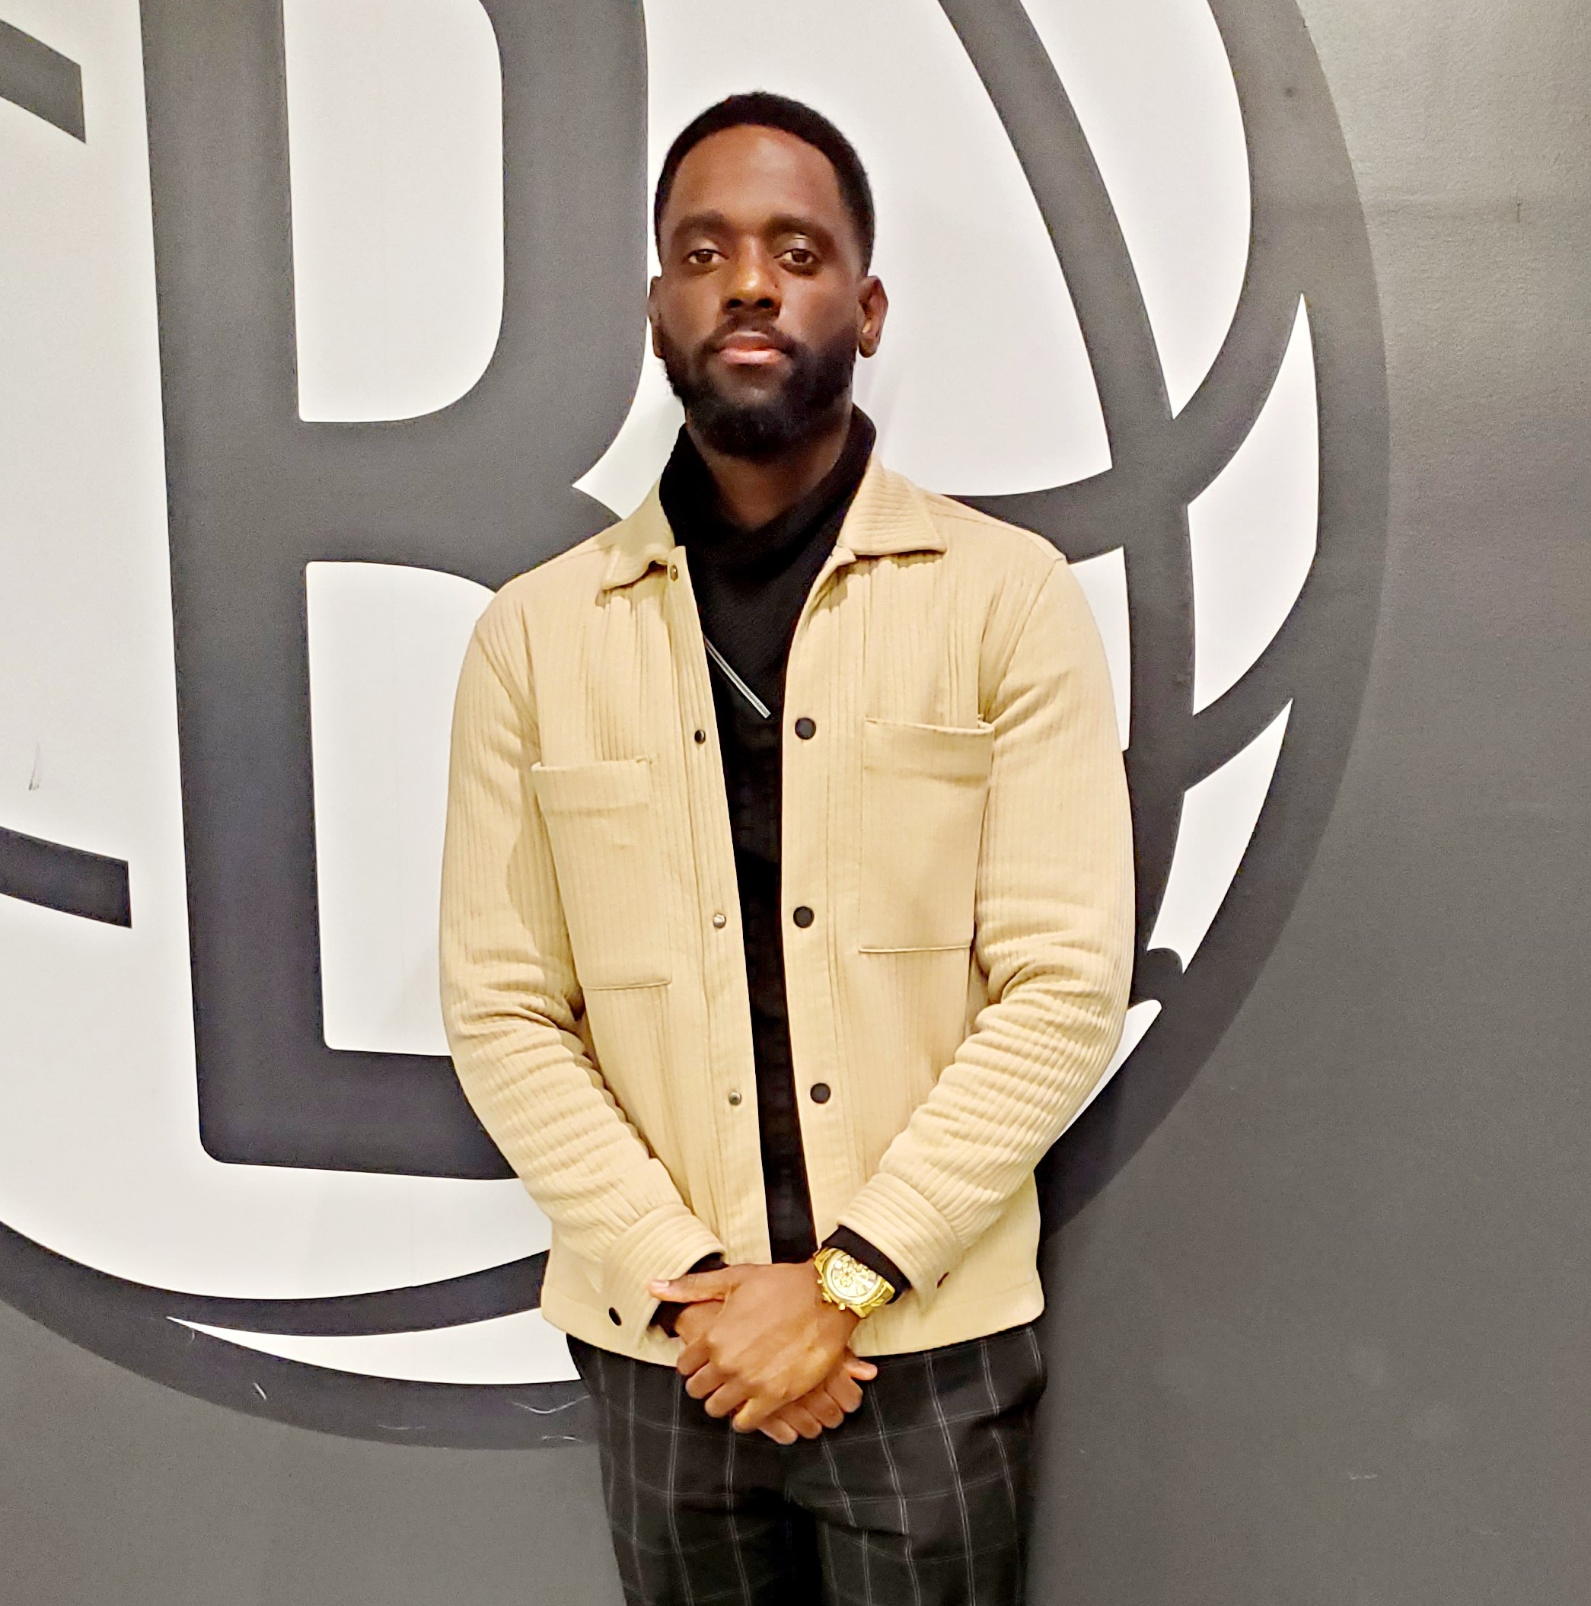
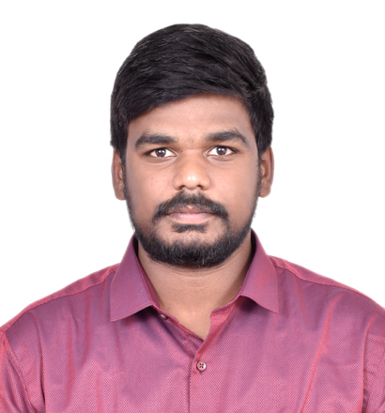
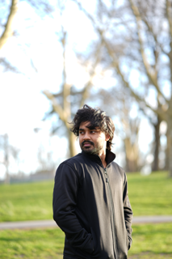
TEAM ROLE & RESPONSIBILITIES
Steve St Fleur
Developer
Venkat Sai Pallapu​
Developer
Pavan Polireddy
Developer​

Slide 5
Improvements
User Stories:
Be specific about the user
Technology:
Be specific about what technology is used for
Team Agreement:
Add more specific DoD (Sprint DoD, Story Level DoD)
MVP Page:
Be more specific about the MVP features
Test Cases:
The test cases are based on the user stories
Stories Completed, Committed Ratio:
Didn't post screenshots & show the percentage
Retrospective:
Did not mention anything about the application, only about improving as team
Wiki Page:
Removed "Deliverables" from page & make the YouTube videos more high resolution

Slide 6

PROBLEM STATEMENT
Understanding foreign languages is often a challenge, as each language has its own unique structure, nuances, and meanings. Effective communication with native speakers becomes difficult without proper understanding, yet mastering every language is nearly impossible. To address this issue, we aim to create an application that helps bridge the communication gap by converting audio into transcriptions in multiple languages, enabling people to understand and engage in conversations more easily.

Slide 7
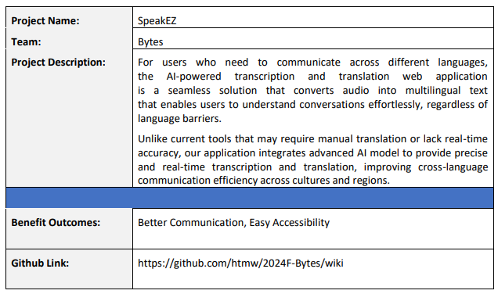

PROJECT DESCRIPTION

Slide 8
TEAM WORKING AGREEMENT
Communication:
The team will communicate with each other through Zoom and WhatsApp.
Google Docs will be utilized for collaborative document editing, sharing resources, and taking notes during team discussions.
Team members should alert the team in advance if they are unable to join a Zoom meeting.
Team members are expected to provide regular updates on task progress and promptly communicate any obstacles or delays to the group.
Team members are encouraged to actively participate in discussions, providing feedback and support as needed.
During all discussions, team members should listen carefully, speak clearly, and stay on topic to avoid confusion
Each team member should complete all assigned work before the deadline. If they are struggling with a task, they should contact the team as soon as possible to resolve the issue. Failure to complete work before the deadline can negatively affect the team’s project timeline.

Slide 9
TEAM WORKING AGREEMENT
Work Division & Participation:
Jira, and GitHub will be used to track and divide all tasks.
The entire project should be divided into equal parts, and all team members should be given equal responsibility.
If a team member is not participating to the level the other members are, the team leader is permitted to assign necessary tasks to that member.
Each team member is responsible for their assigned tasks and their contribution to the overall success of the project.

Slide 10
TEAM WORKING AGREEMENT
Meetings:
Regular team meetings will be scheduled twice a week on Sundays at 2:00 pm and Thursdays at 5:30 pm via zoom to review individual and collective progress. Failing to join these meetings will negatively affect the group.
If unable to attend a scheduled meeting, team members should inform the group in advance.
In urgent situations, additional meetings may be arranged with at least 24 hours’ notice.
Meeting agendas will be sent at least 24 hours prior to the meeting.
Meetings will commence and conclude on time, with members expected to join 2 minutes prior to the start.
All team members are required to have their Zoom cameras open during the meetings. They are required to show respect, actively listen, and participate by sharing feedback or suggestions.
Team agrees to follow these agile practices throughout the project:
Meet at the beginning of each sprint to discuss tasks for the upcoming sprint.
Meet at the end of each sprint to present the completed work and gather feedback.

Slide 11
TEAM WORKING AGREEMENT
Respect and Professionalism:
All communication and interaction within the team will be conducted with respect; diverse viewpoints and inputs should be appreciated.
Feedback should be constructive and centered on the project and not on personal traits.
If a member disagrees with a decision, they can request a review at the next team meeting.
The team aims to create a welcoming space where everyone feels comfortable sharing their ideas
Any disagreements should be addressed openly and respectfully within the team. If an internal resolution is not possible, the team will seek advice from the professor.

Slide 12
TEAM WORKING AGREEMENT
Definition of Done (MVP DoD) for the Language Translator App:
The application can transcribe the given audio into text without error.
The application can successfully translate the transcribed audio to the specified language without errors.
A user is able to upload or delete an audio file to the application without errors.
Codes have been reviewed and approved by all team members.
The app has been manually tested for usability and performance.
Codes are documented with comments where necessary.

Slide 13
TEAM WORKING AGREEMENT
Definition of Done (Sprint DoD) for the Language Translator App:
All required presentation slides are complete
The Wiki Page documents are posted and all links are responsive
The retrospective, sprint planning, presentation, and demo videos are recorded and posted
The Technical Paper and User Manual are complete (later Sprints)
Definition of Done (User Story DoD) for the Language Translator App:
Code has been reviewed by all team members
Code has been tested by a team member

Slide 14
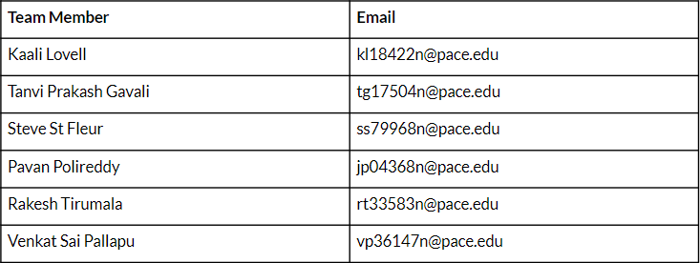
TEAM WORKING AGREEMENT

Slide 15

PERSONAS

Slide 16
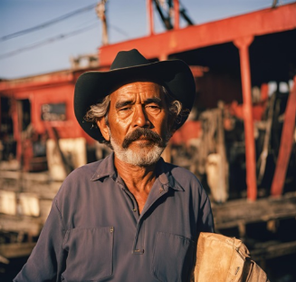
JOSÉ RODRIGUEZ, DOCKS WORKER
Demographics:
Age: 53
Gender: Male
Location: Louisiana, USA
Education: High school diploma
Experience: 15+ years
Skills and Qualifications:
Forklift License
Management in handling and securing cargo using forklifts
Excellent team worker, organized, and physically capable
Goals and Needs:
José is originally from Mexico but has relocated to USA for better working opportunities for his children. He can understand very little English as most of his coworkers speak Spanish as well. During his old age, he started having frequent visits to the doctors where they speak in English with him, which he has difficulty understanding. He does not want to burden his children with the task of translating, and wants to retain confidentiality between himself and his doctor. It is also expensive to hire professional translators - beyond his budget. Jose is looking for an application where he can converse with the doctors without any communication hindrances, and keep transcripts as part of his medical record - both before and after translation.

Slide 17

ANJALI CHITRE, LAWYER
Demographics:
Age: 27
Gender: Female
Location: Edinburgh, UK
Education: LLM in International Law
Experience: 4+ years
Skills and Qualifications:
Skilled in conducting in-depth research regarding international legal issues
Proficient in explaining legal concepts and mediating in legal cases
Professional, showcasing confidence and problem solving skills.
Goals and Needs:
Anjali’s job is to provide legal advice to multinational corporations who need to comply with different regulations for both their U.K and Swedish subsidiaries. To not disclose business information and legal strategies to a 3rd party, Anjali would like an application which can transcribe and translate discussion during meetings without breaching confidentiality or having to create further confidentiality agreements with translators.

Slide 18

NICOLE SCHULER, EXECUTIVE ADMINISTRATIVE ASSISTANT
Demographics:
Age: 27
Gender: Female
Location: Toronto, CA
Education: Bachelors of Business Administration (BBA)
Experience: 1 years
Skills and Qualifications:
Proficient in Excel, Microsoft Office, Outlook, Google Workspace
Certified Administrative Professional (CAP)
Excellent organizational, administrative, and interpersonal skills
Goals and Needs:
Nicole is originally from NYC but has relocated to Canada for work. Nicole has to attend daily meetings and transcribe the meetings for her higher-ups. Some of her co-workers switch between French and English in the meetings which frustrates Nicole since her native language is English and she has no experience with French. Nicole is looking for a tool that will help her efficiently transcribe the meetings and also assist with translating the French terms.

Slide 19
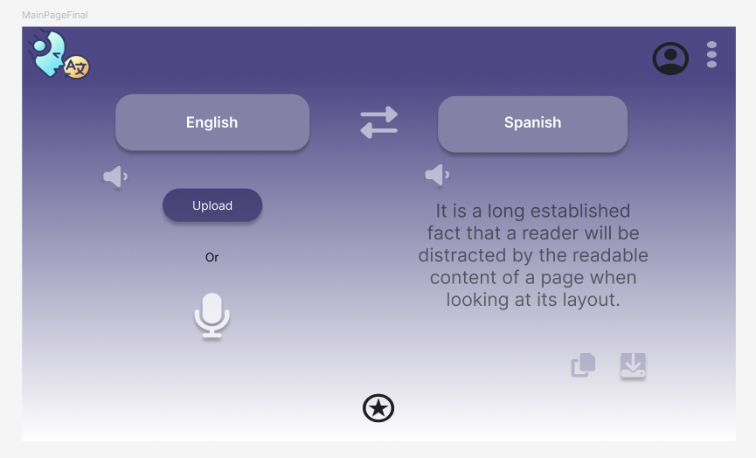
MVP Design
Upload Audio
User should be able to upload a .mp3 file from their computer.
The application should not allow any other file type to be uploaded.
User should be able to remove the audio file once it was uploaded.
Record Audio from Mic
User should be able to use our application, SpeakEZ, to record audio.
Transcribe Audio
The application should transcribe the audio that was uploaded by the user.
Language Selection:
User should be able to select the language they want to translate their transcription into.
Translate Transcription
The application should translate the transcription in the language the user desires.

Slide 20













TECHNOLOGIES
Programming Languages and Frameworks | Libraries | Tools | Deployment
SpeakEZ uses these applications for the dynamic user interface. | Vite- used to build and develop the front end for SpeakEZ MaterialUI- React component for the user interface TailwindCSS- CSS framework for creating responsive designs HuggingFace- assists with building AI powered applications | GitHub- remote version control & collaborative development VSCode- code editor Figma- application brainstorming design Jira- project management | Firebase database is used to store the user's translated and transcribed text.
HTML5
CSS
Vite
HuggingFace
GitHub
VSCode
Firebase
JavaScript
React
MaterialUI
TailwindCSS
Figma
Jira

Slide 21

ALGORITHMS
The application should be able to take audio as input and convert it into the desired language. To achieve this, we need an AI model for automatic speech recognition and speech translation. So, the most suitable neural network to use in order to perform this task is a Transformer.

Slide 22
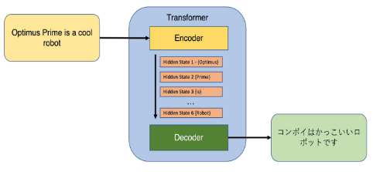
ALGORITHMS
A transformer is a neural network architecture especially designed for processing sequential data like natural language processing (NLP).
They usually use an encoder-decoder structure but make use of attention mechanism in order to capture relationships between elements in a sequence. Unlike RNNs, transformers process data in parallel which makes them faster and more scalable.

Slide 23
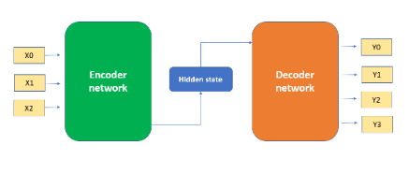
ALGORITHMS
In the encoder-decoder structure, the encoder processes the input data, which can be text, audio, etc., and generates encodings. The decoder takes these encodings, uses the derived context, and generates the output sequence.

Slide 24
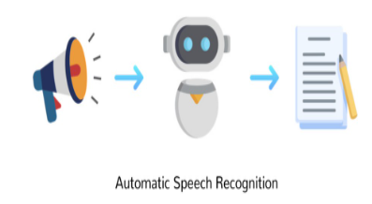
ALGORITHMS
Whisper is a transformer based on the encoder-decoder structure. It was trained on 680,000 hours of labelled speech data. The model can perform both speech recognition and speech translation.

Slide 25
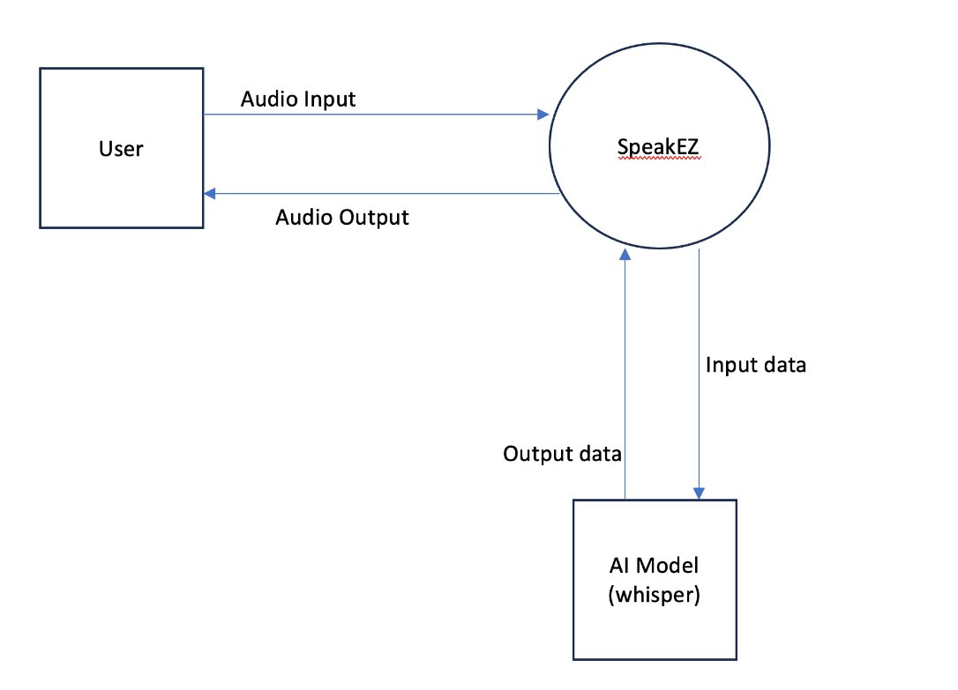
Context Diagram

Slide 26
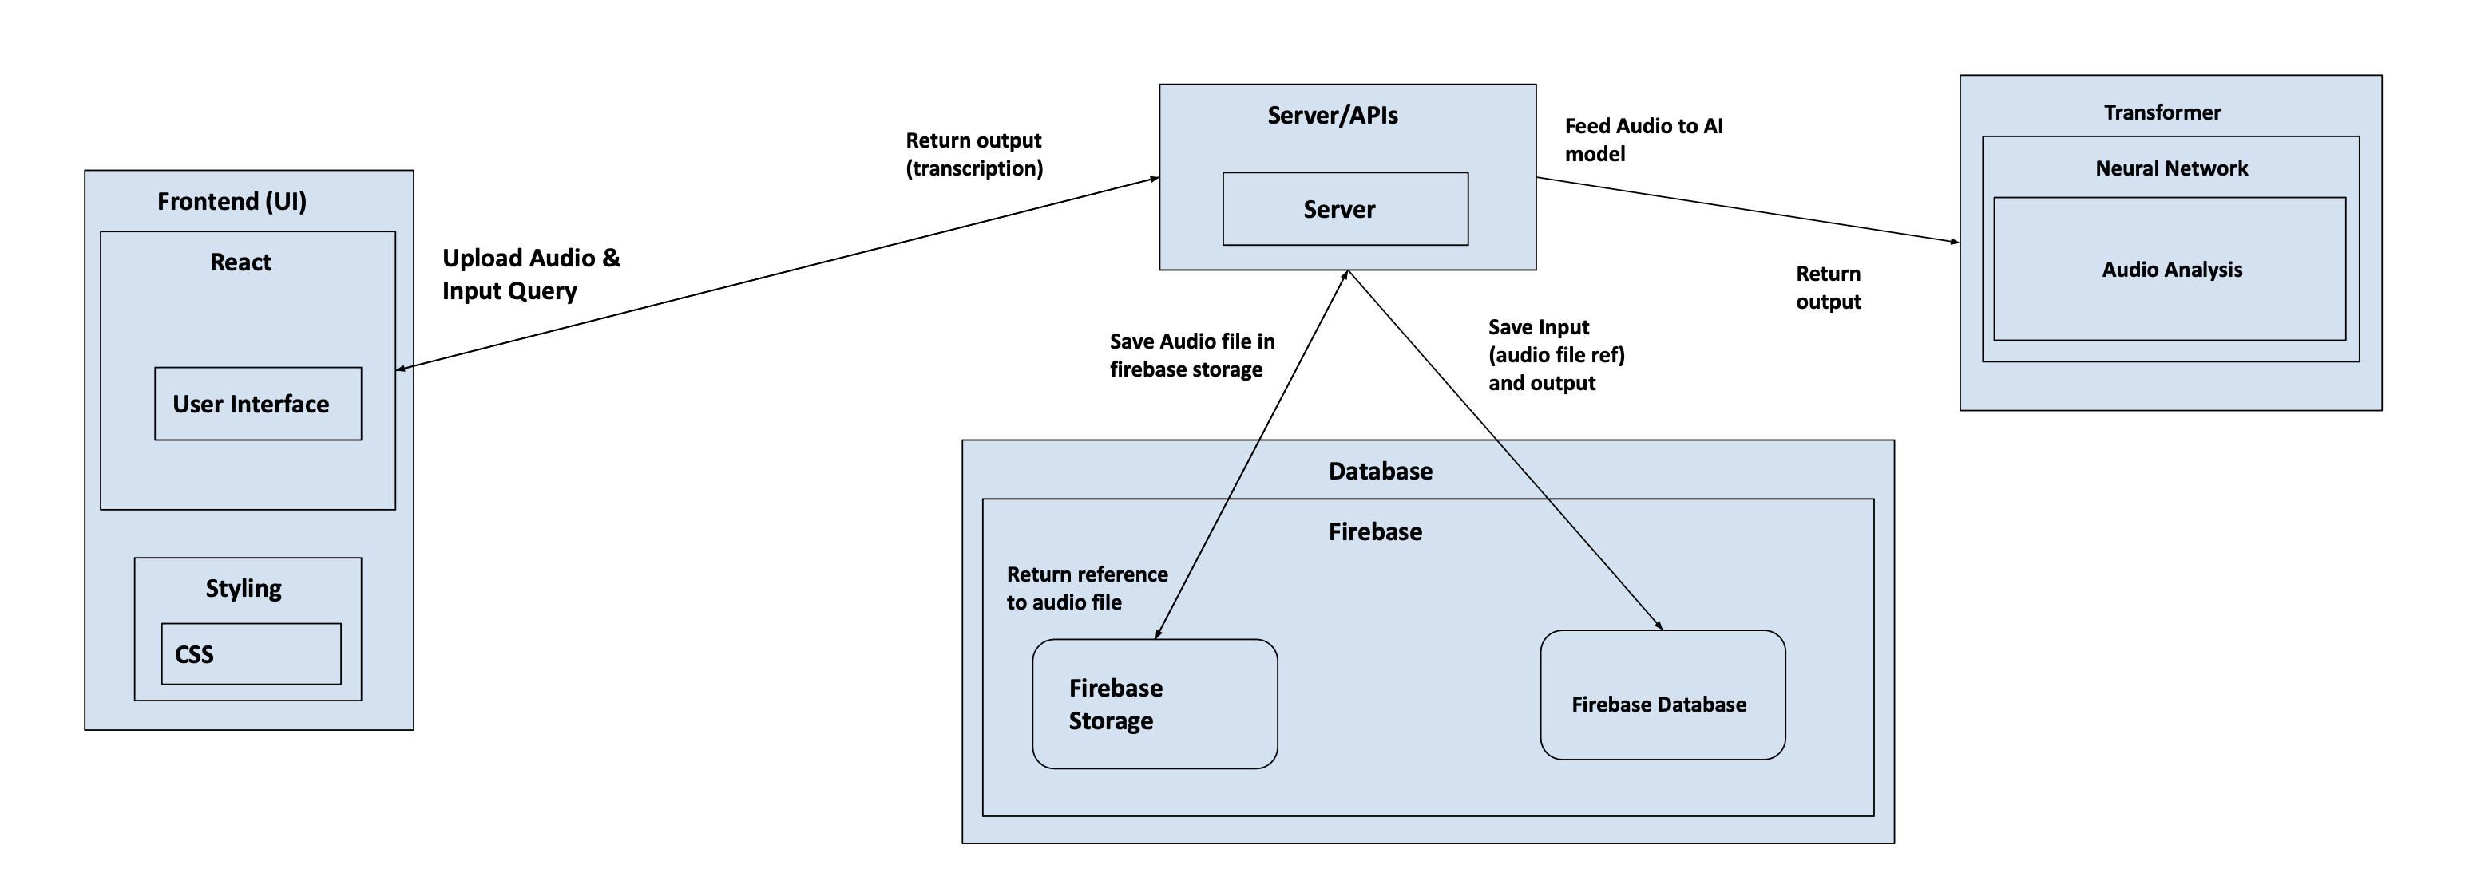
Architecture Diagram

Slide 27
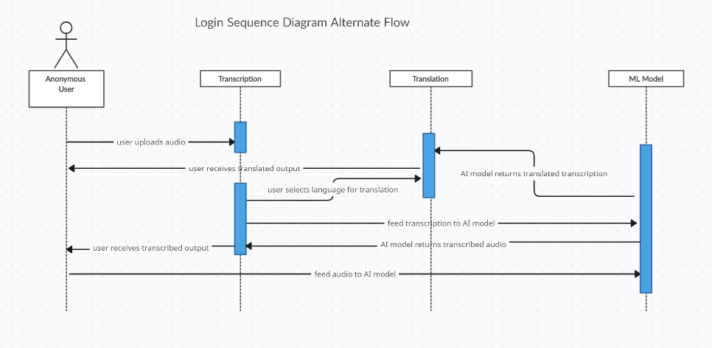
Sequence Diagram

Slide 28
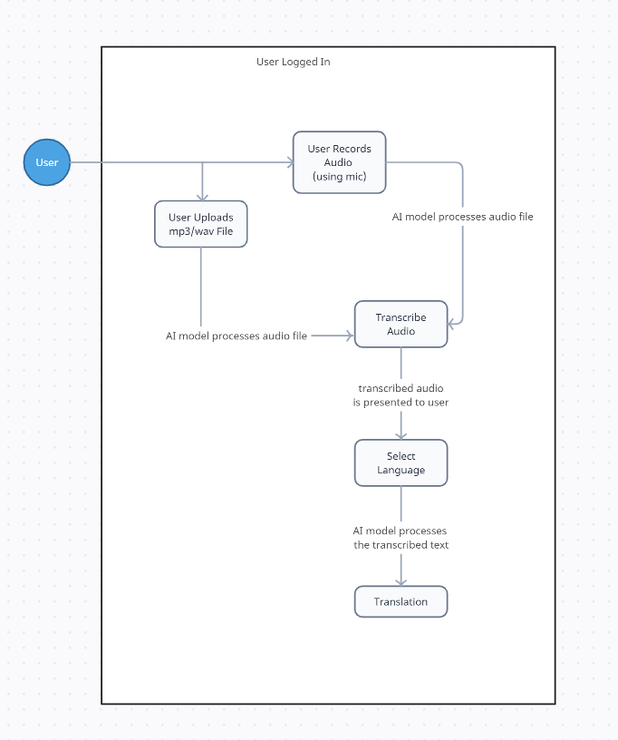
State Diagram

Slide 29
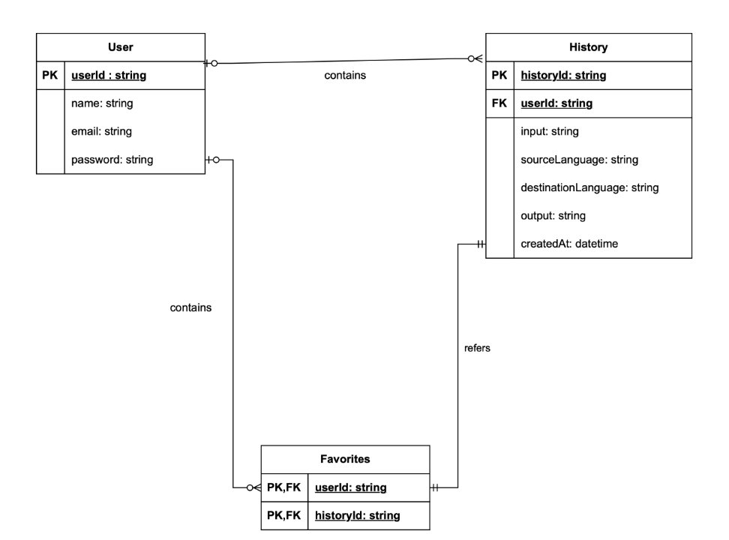
Class Diagram

Slide 30
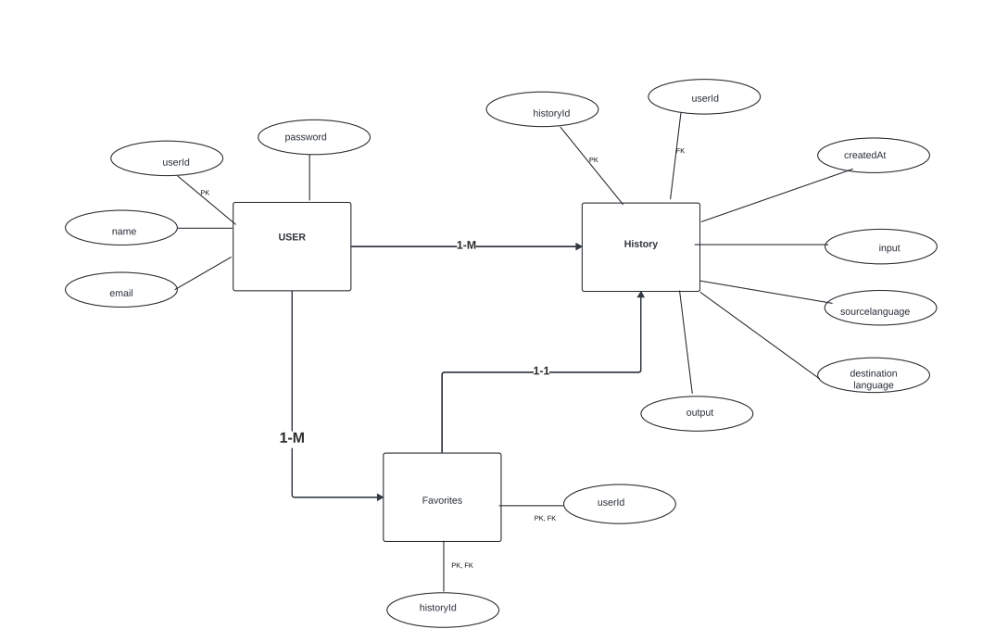
ER Diagram

Slide 31
Sprint 1 Recap
Designed the UI for the SpeakEZ application
Upload audio file
Transcribe uploaded audio file
User sign-in drop down
Language selection drop down
42 Story Points
Completed 100% of the Story Points

Slide 32
Product Backlog
User Story ID | Point estimated | As a(n) | I want | So that | Feature
LTA-115 | 2 | Admin | to have an "Upload" button. | I can easily select and upload a file for translation. | Upload Button
LTA-117 | 3 | Admin | to see the progress of a file upload for translation . | I know when the upload is completed and the file is ready for translation. | Progress Indicator
LTA-146 | 3 | Admin | to be notified about the progress of the audio file transcription. | I know the transcription is complete and ready for use. | Progress Indicator
LTA-145 | 2 | Admin | to copy the transcribed text from the text box,. | I can use the transcription in other applications. | Copy Button
LTA-144 | 5 | Admin | the transcribed text to be displayed in a text box after I upload an audio file. | I can view the transcription easily. | Text box
LTA-143 | 3 | Developer | to ensure the Worker handles and processes messages from the Whisper model in correct order. | the transcription tasks are processed accurately and sequentially. | Worker Queue System
LTA-142 | 3 | Developer | to send the audio data to the Whisper model for transcription. | I can obtain the transcribed text from the audio. | Whisper Model
LTA-141 | 3 | Developer | to be able convert audio files into audio data. | the data can be processed for transcription by the Whisper model. | Whisper Model
The User Story ID Number is our Jira Ticket ID

Slide 33
Product Backlog
User Story ID | Point estimated | As a(n) | I want | So that | Feature
LTA-140 | 5 | Developer | to implement worker functionality to handle incoming messages from the Whisper model. | the system can process audio transcription requests efficiently in the background. | Worker Functionality
LTA-139 | 5 | Developer | to configure the integration with the AI model to process user audio or file input and display the translated output. | users can submit non-text inputs and receive an accurate translation. | AI Model
LTA-136 | 1 | Admin | to see a header at the top of the page with a logo on the left. | I can easily identify the tool's branding. | Header with Logo
LTA-125 | 3 | Admin | a dropdown menu for selecting the input language. | I can choose any available language for translation. | Dropdown Menu
LTA-123 | 3 | Admin | to select the languages for translation before recording audio. | I can ensure the translation is done between my preferred languages. | Dropdown Menu
LTA-121 | 2 | Admin | to be able to confirm or cancel my voice input after recording. | I can ensure the correct input is used for translation. | Confirm / Cancel buttons
The User Story ID Number is our Jira Ticket ID

Slide 34
Product Backlog
User Story ID | Point estimated | As a(n) | I want | So that | Feature
LTA-138 | 5 | Admin | to configure the Firebase database by following the provided UML diagram | the database structure aligns with the system’s requirements and functions efficiently. | Configure Firebase Database Based on UML Diagram
LTA-118 | 2 | Customer | to be informed if the file I upload exceeds the size limit | I can upload a smaller file or take appropriate action. | File Size Limitation
LTA-116 | 1 | Student | to see an error message when I upload an unsupported file type | I am informed about the file type restrictions and can take corrective action. | Error Message for Unsupported File Types
LTA-127 | 3 | Teacher | to quickly copy the translated text | I can paste it into other applications. | Copy Translated Text
LTA-119 | 3 | Diplomat | to have a "Microphone" button | I can record my voice input for translation without typing. | Microphone Button for Voice Input
LTA-124 | 2 | Lawyer | to be informed if my audio recording exceeds a certain time limit | I can manage the length of my input and avoid losing the recording. | Audio Input Time Limitation
LTA-120 | 5 | Doctor | the system to accurately translate my recorded audio into another language | I can understand the content in a different language. | Accurate Translation of Audio Input
LTA-122 | 2 | Elderly user | to see visual indicator during the audio recording | I know when my voice is being recorded. | Audio Recording Indicator
The User Story ID Number is our Jira Ticket ID

Slide 35
Product Backlog
User Story ID | Point estimated | As a(n) | I want | So that | Feature
LTA-126 | 2 | Student | a dropdown menu for selecting the output language | I can receive translations in any language of my choice. | Dropdown for Output Language Selection
LTA-131 | 3 | Multilinguistic | the system to save all my past translations | I can access my full translation history at any time. | Ability to Save All Past Translations
LTA-129 | 2 | Patient | to download the translated text in different file formats (e.g., .txt, .docx) | I can choose the format that best suits my needs. | Supported Formats for Downloaded File
LTA-128 | 2 | Working Professional | a "Download" button next to the translated text | I can download and save the translated content for future use. | Download Button for Translated Text
LTA-151 | 1 | Team | make necessary modifications in our project as per professor’s feedback | we deliver better presentation next sprint | Improvement Feedback from Sprint 1
LTA-149 | 2 | Team Member | update the wiki page with our current deliverable | customers can checkout our current progress for this sprint | Wiki Page for Sprint 2
LTA-148 | 5 | Client | like to know more about the product through a detailed technical paper | I can have documented understanding of the product. | Technical Report
LTA-130 | 3 | Accountant | to be able to reuse my past translations | I can revisit previous translations without re-entering the same text. | Ability to Reuse Past Translations
LTA-137 | 2 | Frequent user | to access my profile and settings through dropdown menus on the right side of the header | I can manage my account and customize my | Dropdown Menus for Profile and Settings
The User Story ID Number is our Jira Ticket ID

Slide 36
Product Backlog
User Story ID | Point estimated | As a(n) | I want | So that | Feature
LTA-132 | 5 | Student | a toggle button to switch between light and dark modes | I can change the interface based on my preference. | Toggle Button for Light/Dark Mode
LTA-133 | 3 | Elder person | my theme preference (light or dark mode) to be saved | I can continue using my preferred mode across different sessions without resetting it. | Persisting Theme Preference Across Sessions
LTA-134 | 3 | Editor | to mark a translation as a favorite by clicking a star icon | I can easily identify and access important translations later. | Marking and Unmarking a Translation as a Favorite
LTA-135 | 5 | Artist | to access my saved favorite translations in a dedicated "Favorites" section | I can easily find and reuse my important translations. | Accessing Favorite Translations
The User Story ID Number is our Jira Ticket ID

Slide 37
Sprint 2 Backlog
User Story ID | Point estimated | As a(n) | I want | So that | Feature
LTA-138 | 5 | Admin | to configure the Firebase database by following the provided UML diagram | the database structure aligns with the system’s requirements and functions efficiently. | Configure Firebase Database Based on UML Diagram
LTA-118 | 2 | Customer | to be informed if the file I upload exceeds the size limit | I can upload a smaller file or take appropriate action. | File Size Limitation
LTA-116 | 1 | Student | to see an error message when I upload an unsupported file type | I am informed about the file type restrictions and can take corrective action. | Error Message for Unsupported File Types
LTA-127 | 3 | Teacher | to quickly copy the translated text | I can paste it into other applications. | Copy Translated Text
LTA-119 | 3 | Diplomat | to have a "Microphone" button | I can record my voice input for translation without typing. | Microphone Button for Voice Input
LTA-124 | 2 | Lawyer | to be informed if my audio recording exceeds a certain time limit | I can manage the length of my input and avoid losing the recording. | Audio Input Time Limitation
LTA-120 | 5 | Doctor | the system to accurately translate my recorded audio into another language | I can understand the content in a different language. | Accurate Translation of Audio Input
LTA-122 | 2 | Elderly user | to see visual indicator during the audio recording | I know when my voice is being recorded. | Audio Recording Indicator
LTA-126 | 2 | Student | a dropdown menu for selecting the output language | I can receive translations in any language of my choice. | Dropdown for Output Language Selection
LTA-131 | 3 | Multilinguistic | the system to save all my past translations | I can access my full translation history at any time. | Ability to Save All Past Translations
LTA-129 | 2 | Patient | to download the translated text in different file formats (e.g., .txt, .docx) | I can choose the format that best suits my needs. | Supported Formats for Downloaded File
LTA-128 | 2 | Working Professional | a "Download" button next to the translated text | I can download and save the translated content for future use. | Download Button for Translated Text
LTA-151 | 1 | Team | make necessary modifications in our project as per professor’s feedback | we deliver better presentation next sprint | Improvement Feedback from Sprint 1
LTA-149 | 2 | Team Member | update the wiki page with our current deliverable | customers can checkout our current progress for this sprint | Wiki Page for Sprint 2
LTA-148 | 5 | Client | like to know more about the product through a detailed technical paper | I can have documented understanding of the product. | Technical Report
LTA-130 | 3 | Accountant | to be able to reuse my past translations | I can revisit previous translations without re-entering the same text. | Ability to Reuse Past Translations
LTA-137 | 2 | Frequent user | to access my profile and settings through dropdown menus on the right side of the header | I can manage my account and customize my | Dropdown Menus for Profile and Settings
The User Story ID Number is our Jira Ticket ID

Slide 38
Sprint 2 User Stories
Key | Feature | Summary | Criteria | Points
LTA-138 | As an admin, I want to configure the Firebase database by following the provided UML diagram, so that the database structure aligns with the system’s requirements and functions efficiently. |  |  | 5
 | Configure Firebase Database Based on UML Diagram | Given I am an admin, I want to configure the Firebase database by following the provided UML diagram, so that the database structure aligns with the system’s requirements and functions efficiently. | · Implement the database structure in Firebase as per the attached UML diagram. · Set up collections and documents to match the entities and relationships shown in the UML. · Verify that the database supports the required operations (e.g., create, read, update, delete). · Test the Firebase database setup to ensure it meets the system’s performance and security standards.
LTA-118 | As a customer, I want to be informed if the file I upload exceeds the size limit, so that I can upload a smaller file or take appropriate action. |  |  | 2
 | File Size Limitation | Given I am a customer, I want to be informed if the file I upload exceeds the size limit, so that I can upload a smaller file or take appropriate action. | The system supports file uploads up to a specified size limit (e.g., 20 MB). An error message is displayed if the user attempts to upload a file larger than the size limit.
LTA-116 | As a student, I want to see an error message when I upload an unsupported file type, so that I am informed about the file type restrictions and can take corrective action. |  |  | 1
 | Error Message for Unsupported File Types | Given I am a student, I want to see an error message when I upload an unsupported file type, so that I am informed about the file type restrictions and can take corrective action. | If a user uploads a file type that is not supported, an error message appears. The error message should clearly state the supported file types.
The User Story ID Number is our Jira Ticket ID

Slide 39
Sprint 2 User Stories
Key | Feature | Summary | Criteria | Points
LTA-127 | As a teacher, I want to quickly copy the translated text, so that I can paste it into other applications. |  |  | 3
 | Copy Translated Text | Given I am a teacher, I want to quickly copy the translated text, so that I can paste it into other applications. | Copy button for translated text. Text is copied to clipboard when clicked. Confirmation message (e.g. “Text copied”)
LTA-119 | As a diplomat, I want to have a "Microphone" button, so that I can record my voice input for translation without typing. |  |  | 3
 | Microphone Button for Voice Input | Given I am a diplomat, I want to have a "Microphone" button, so that I can record my voice input for translation without typing. | A "Microphone" button is available for starting voice recording. Clicking the "Microphone" button begins recording the user's audio input. The system stops recording when the button is clicked again or a time limit is reached.
LTA-124 | As a lawyer, I want to be informed if my audio recording exceeds a certain time limit, so that I can manage the length of my input and avoid losing the recording. |  |  | 2
 | Audio Input Time Limitation | Given I am a lawyer, I want to be informed if my audio recording exceeds a certain time limit, so that I can manage the length of my input and avoid losing the recording. | The system enforces a maximum recording time (e.g., 2 minutes). An error message or notification is shown if the user exceeds the recording limit.
The User Story ID Number is our Jira Ticket ID

Slide 40
Sprint 2 User Stories
Key | Feature | Summary | Criteria | Points
LTA-120 | As a doctor, I want the system to accurately translate my recorded audio into another language, so that I can understand the content in a different language. |  |  | 5
 | Accurate Translation of Audio Input | Given I am a doctor, I want the system to accurately translate my recorded audio into another language, so that I can understand the content in a different language. | The system processes the recorded audio and translates it into the selected target language. The translation is displayed after processing is completed. The translation reflects the meaning of the original audio input as accurately as possible.
LTA-122 | As an elderly user, I want to see visual indicator during the audio recording, so that I know when my voice is being recorded. |  |  | 2
 | Audio Recording Indicator | As an elderly user, I want to see visual indicator during the audio recording, so that I know when my voice is being recorded. | A visual indicator (such as a blinking icon or sound wave animation) is displayed when the recording is in progress. The indicator stops when the recording is finished or cancelled.
LTA-126 | As a student, I want a dropdown menu for selecting the output language, so that I can receive translations in any language of my choice. |  |  | 2
 | Dropdown for Output Language Selection | Given I am a student, I want a dropdown menu for selecting the output language, so that I can receive translations in any language of my choice. | A dropdown menu is available next to the output field for selecting the output language. The dropdown displays a list of available languages for the user to choose from. The user can select any language from the list as the output language.
The User Story ID Number is our Jira Ticket ID

Slide 41
Sprint 2 User Stories
Key | Feature | Summary | Criteria | Points
LTA-131 | As a multilinguistic, I want the system to save all my past translations, so that I can access my full translation history at any time. |  |  | 3
 | Ability to Save All Past Translations | Given I am a multilinguistic, I want the system to save all my past translations, so that I can access my full translation history at any time. | The system automatically saves all translations made by the user. Users can access their full history of past translations from a dedicated section (e.g., "Translation History"). Past translations are stored persistently across sessions, allowing users to revisit them later.
LTA-129 | As a patient, I want to download the translated text in different file formats (e.g., .txt, .docx), so that I can choose the format that best suits my needs. |  |  | 2
 | Supported Formats for Downloaded File | Given I am a patient, I want to download the translated text in different file formats (e.g., .txt, .docx), so that I can choose the format that best suits my needs. | The system offers options to download the translated content in supported formats such as .txt and .docx. The downloaded file contains the translated text in the chosen format.
LTA-128 | As a working professional, I want a "Download" button next to the translated text, so that I can download and save the translated content for future use. |  |  | 2
 | Download Button for Translated Text | Given I am a working professional, I want a "Download" button next to the translated text, so that I can download and save the translated content for future use. | A "Download" button is displayed next to the translated text. Clicking the "Download" button triggers the download of the translated content.
The User Story ID Number is our Jira Ticket ID

Slide 42
Sprint 2 User Stories
Key | Feature | Summary | Criteria | Points
LTA-151 | As a team, we want to make necessary modifications in our project as per professor’s feedback so that we deliver better presentation next sprint |  |  | 1
 | Improvement Feedback from Sprint 1 | Given we are a team, we want to make necessary modifications in our project as per professor’s feedback so that we deliver better presentation next sprint
LTA-149 | As a team member, I want to update the wiki page with our current deliverable so that customers can checkout our current progress for this sprint |  |  | 2
 | Wiki Page for Sprint 2 | Given I am a team member, I want to update the wiki page with our current deliverable so that customers can checkout our current progress for this sprint
LTA-148 | As a client, I want to like to know more about the product through a detailed technical paper so that I can have documented understanding of the product. |  |  | 5
 | Technical Report | Given I am a client, I would like to know more about the product through a detailed technical paper so that I can have documented understanding of the product.
The User Story ID Number is our Jira Ticket ID

Slide 43
Sprint 2 User Stories
Key | Feature | Summary | Criteria | Points
LTA-130 | As an accountant, I want to be able to reuse my past translations, so that I can revisit previous translations without re-entering the same text. |  |  | 3
 | Ability to Reuse Past Translations | Given I am an accountant, I want to be able to reuse my past translations, so that I can revisit previous translations without re-entering the same text. | Users can view a list of their past translations. Users can select any past translation from the list to reuse it. The system automatically populates the input and output fields with the previously translated content when selected.
LTA-137 | As a frequent user, I want to access my profile and settings through dropdown menus on the right side of the header, so that I can manage my account and customize my preferences easily. |  |  | 2
 | Dropdown Menus for Profile and Settings | Given I am a frequent user, I want to access my profile and settings through dropdown menus on the right side of the header, so that I can manage my account and customize my preferences easily. | A "My Profile" dropdown is available on the right side, providing access to user profile details. A "Settings" dropdown is present on the right side, offering options such as language and theme settings. Dropdown menus expand when clicked and collapse when not in use.
The User Story ID Number is our Jira Ticket ID

Slide 44
Test Cases
The User Story ID Number is our Jira Ticket ID
User Key | User Story | Test Key | Test | SubTest | Test Steps | Expected Result | Actual Result | Pass/ Fail
LTA-118 | As a customer, I want to be informed if the file I upload exceeds the size limit, so that I can upload a smaller file or take appropriate action. | LTA-160 | Verify File Upload Size Limit and Error Handling | Confirm that the system supports file uploads up to the specified size limit (e.g., 20 MB). Test uploading files larger than the size limit and verify that an error message is displayed. Ensure the error message is clear and instructs the user on the file size limit. | Browse -> upload mp3 > 20MB | Should throw an error message when file is uploaded more than 20MB. | An error message is displayed if tried to upload a file greater than 20MB. | PASS
LTA-116 | As a student, I want to see an error message when I upload an unsupported file type, so that I am informed about the file type restrictions and can take corrective action. | LTA-161 | Verify Error Message for Unsupported File Types | Test uploading an unsupported file type and verify that an error message appears. Ensure the error message clearly specifies the supported file types. Check the error message format and clarity to ensure users can easily understand the restrictions. | Browse -> upload mp4, doc | Should throw an error message for unsupported file types. | An error message is displayed if mp3 or other unsupported file types are uploaded. | PASS
LTA-127 | As a teacher, I want to quickly copy the translated text, so that I can paste it into other applications. | LTA-162 | Verify Copy Functionality for Translated Text | Ensure a copy button is available next to the translated text. Verify that clicking the copy button copies the translated text to the clipboard. Check that a confirmation message (e.g., “Text copied”) appears when the button is clicked. | Browse -> upload mp3 file > click Translate > click 'copy' icon | Text should be copied to clipboard. Should be able to paste the copied text | Text is copied to clipboard notifying the user. Able to paste the copied text on a notepad. | PASS

Slide 45
Test Cases
The User Story ID Number is our Jira Ticket ID
User Key | User Story | Test Key | Test | SubTest | Test Steps | Expected Result | Actual Result | Pass/Fail
LTA-119 | As a diplomat, I want to have a "Microphone" button, so that I can record my voice input for translation without typing. | LTA-166 | Verify Microphone Button Functionality for Voice Input | Ensure the "Microphone" button is available for starting voice recording. Verify that clicking the "Microphone" button starts recording the user's audio input. Confirm that clicking the button again or reaching a time limit stops the recording. | Click on microphone icon | The "Microphone" button should be visible and accessible to the user for starting voice recording. Clicking should initiate the recording process, capturing the user's audio input. Clicking again or reaching a predefined time limit should stop the recording process. | The "Microphone" button should be visible and accessible to the user for starting voice recording. Clicking should initiate the recording process, capturing the user's audio input. Clicking again or reaching a predefined time limit should stop the recording process. | PASS
LTA-120 | As a doctor, I want the system to accurately translate my recorded audio into another language, so that I can understand the content in a different language. | LTA-172 | Verify "Audio Translation" Functionality | Ensure the system processes the recorded audio and translates it into the selected target language. Verify that the translation is displayed after the processing is completed. Check that the translation accurately reflects the meaning of the original audio input. | Browse -> upload mp3 -> click 'translate' | The system should process the audio input, and display the translated text. | The system processes audio input and displays as translated text successfully. | PASS

Slide 46
Test Cases
The User Story ID Number is our Jira Ticket ID
User Key | User Story | Test Key | Test | SubTest | Test Steps | Expected Result | Actual Result | Pass/Fail
LTA-122 | As a elderly user, I want to see visual indicator during the audio recording, so that I know when my voice is being recorded. | LTA-159 | Verify Visual Indicator for Audio Recording | Ensure a visual indicator (e.g., blinking icon or sound wave animation) is displayed during the audio recording process. Confirm that the indicator stops when the recording is finished or cancelled. Test the responsiveness of the indicator to start and stop with the recording process. | Click on microphone icon | Should be able to see a visual red indicator when clicked on the microphone icon. Verify that the microphone icon reappears when the recording is stopped or canceled, transitioning back from the red indicator. | A red indicator is displayed when clicked on the microphone icon. The microphone icon reappeared when the recording was stopped or cancelled, transitioning back as expected. | PASS
LTA-129 | As a patient, I want to download the translated text in different file formats (e.g., .txt, .docx), so that I can choose the format that best suits my needs. | LTA-169 | Verify File Format Download for Translated Text | Ensure the system provides download options for formats such as .txt and .docx. Verify that clicking the download button generates the translated content in the selected format. Confirm that the content in the downloaded file matches the translated text (correct format and no data loss). | Browse -> upload mp3 file > click Translate > click 'download' icon | When download icon clicked, a .txt file should be generated. | When download icon is clicked, the .txt file is generated. | PASS

Slide 47
Test Cases
The User Story ID Number is our Jira Ticket ID
User Key | User Story | Test Key | Test | SubTest | Test Steps | Expected Result | Actual Result | Pass/Fail
LTA-128 | As a working professional, I want a "Download" button next to the translated text, so that I can download and save the translated content for future use. | LTA-170 | Verify "Download" Button Functionality | Ensure the "Download" button is displayed next to the translated text. Verify that clicking the "Download" button triggers the download of the translated content. Check that the downloaded content matches the translated text exactly. | Browse -> upload mp3 file > click Translate > click 'download' icon > open the downloaded .txt file | The .txt file should contain both the transcribed and translated text. | The .txt contains both text as expected. | PASS
LTA-149 | As a team member, I would update the wiki page with our current deliverable so that customers can checkout our current progress for this sprint | LTA-173 | Check updated wiki page | Test all updated links and if able to download in the required formats such as .xslx, .docs and .mp4 | Wiki link -> click all updated links | All links should allow function as required. | All links are functioning as expected. | PASS

Slide 48
Test Cases
The User Story ID Number is our Jira Ticket ID
User Key | User Story | Test Key | Test | SubTest | Test Steps | Expected Result | Actual Result | Pass/Fail
LTA-137 | As a frequent user, I want to access my profile and settings through dropdown menus on the right side of the header, so that I can manage my account and customize my preferences easily. | LTA-168 | Verify Profile and Settings Dropdown Menus | Ensure the "My Profile" dropdown is available on the right side, providing access to user profile details. Verify the "Settings" dropdown is present on the right side, offering options such as language and theme settings. Confirm that dropdown menus expand when clicked and collapse when not in use. | Browse > upload mp3 file > Translate > Control + Shift + I (developer's tool) | Profile dropdown and settings dropdown should be visible for user to access his profile. It should display correctly across all dimensions when responsive | Profile dropdown and settings dropdown are showing for user to access his profile | PASS
 |  | LTA-174 | Testing Task: Test the responsiveness of dropdown menus across different screen dimensions | Ensure the menu dropdown is displayed correctly and functions as expected across all screen dimensions when in responsive mode. Verify that the dropdown content is fully accessible and that there are no visual or functional issues at various screen sizes, including desktop, tablet, and mobile views. | Browse > upload mp3 file > Translate > Control + Shift + I (developer's tool) Try different screen dimensions to check the dropdown functionality | The menu dropdown should display correctly and function seamlessly across all screen dimensions when in responsive mode. It should be fully accessible and free of visual or functional issues on desktop, tablet, and mobile views. | The dropdown displays correctly and the feature is working, but it is not responsive to different screen dimensions. | FAIL

Slide 49
Sprint 2 Stories Completed
Key | Feature | Summary | Criteria | Points
LTA-118 | As a customer, I want to be informed if the file I upload exceeds the size limit, so that I can upload a smaller file or take appropriate action. |  |  | 2
 | File Size Limitation | Given I am a customer, I want to be informed if the file I upload exceeds the size limit, so that I can upload a smaller file or take appropriate action. | The system supports file uploads up to a specified size limit (e.g., 20 MB). An error message is displayed if the user attempts to upload a file larger than the size limit.
LTA-116 | As a student, I want to see an error message when I upload an unsupported file type, so that I am informed about the file type restrictions and can take corrective action. |  |  | 1
 | Error Message for Unsupported File Types | Given I am a student, I want to see an error message when I upload an unsupported file type, so that I am informed about the file type restrictions and can take corrective action. | If a user uploads a file type that is not supported, an error message appears. The error message should clearly state the supported file types.
LTA-127 | As a teacher, I want to quickly copy the translated text, so that I can paste it into other applications. |  |  | 3
 | Copy Translated Text | Given I am a teacher, I want to quickly copy the translated text, so that I can paste it into other applications. | Copy button for translated text. Text is copied to clipboard when clicked. Confirmation message (e.g. “Text copied”)

Slide 50
Sprint 2 Stories Completed
Key | Feature | Summary | Criteria | Points
LTA-119 | As a diplomat, I want to have a "Microphone" button, so that I can record my voice input for translation without typing. |  |  | 3
 | Microphone Button for Voice Input | Given I am a diplomat, I want to have a "Microphone" button, so that I can record my voice input for translation without typing. | A "Microphone" button is available for starting voice recording. Clicking the "Microphone" button begins recording the user's audio input. The system stops recording when the button is clicked again or a time limit is reached.
LTA-120 | As a doctor, I want the system to accurately translate my recorded audio into another language, so that I can understand the content in a different language. |  |  | 5
 | Accurate Translation of Audio Input | As an elderly user, I want to see visual indicator during the audio recording, so that I know when my voice is being recorded. | The system processes the recorded audio and translates it into the selected target language. The translation is displayed after processing is completed. The translation reflects the meaning of the original audio input as accurately as possible.
LTA-129 | As a patient, I want to download the translated text in different file formats (e.g., .txt, .docx), so that I can choose the format that best suits my needs. |  |  | 2
 | Supported Formats for Downloaded File | Given I am a patient, I want to download the translated text in different file formats (e.g., .txt, .docx), so that I can choose the format that best suits my needs. | The system offers options to download the translated content in supported formats such as .txt and .docx. The downloaded file contains the translated text in the chosen format.
Key | Feature | Summary | Criteria | Points
LTA-118 | As a customer, I want to be informed if the file I upload exceeds the size limit, so that I can upload a smaller file or take appropriate action. |  |  | 2
 | File Size Limitation | Given I am a customer, I want to be informed if the file I upload exceeds the size limit, so that I can upload a smaller file or take appropriate action. | The system supports file uploads up to a specified size limit (e.g., 20 MB). An error message is displayed if the user attempts to upload a file larger than the size limit.
LTA-116 | As a student, I want to see an error message when I upload an unsupported file type, so that I am informed about the file type restrictions and can take corrective action. |  |  | 1
 | Error Message for Unsupported File Types | Given I am a student, I want to see an error message when I upload an unsupported file type, so that I am informed about the file type restrictions and can take corrective action. | If a user uploads a file type that is not supported, an error message appears. The error message should clearly state the supported file types.

Slide 51
Sprint 2 Stories Completed
Key | Feature | Summary | Criteria | Points
LTA-128 | As a working professional, I want a "Download" button next to the translated text, so that I can download and save the translated content for future use. |  |  | 2
 | Download Button for Translated Text | Given I am a working professional, I want a "Download" button next to the translated text, so that I can download and save the translated content for future use. | A "Download" button is displayed next to the translated text. Clicking the "Download" button triggers the download of the translated content.
LTA-151 | As a team, we want to make necessary modifications in our project as per professor’s feedback so that we deliver better presentation next sprint |  |  | 1
 | Improvement Feedback from Sprint 1 | Given we are a team, we want to make necessary modifications in our project as per professor’s feedback so that we deliver better presentation next sprint
LTA-149 | As a team member, I want to update the wiki page with our current deliverable so that customers can checkout our current progress for this sprint |  |  | 2
 | Wiki Page for Sprint 2 | Given I am a team member, I want to update the wiki page with our current deliverable so that customers can checkout our current progress for this sprint

Slide 52
Sprint 2 Stories Completed
Key | Feature | Summary | Criteria | Points
LTA-122 | As an elderly user, I want to see visual indicator during the audio recording, so that I know when my voice is being recorded. |  |  | 2
 | Audio Recording Indicator | Given I am an elderly user, I want to see visual indicator during the audio recording, so that I know when my voice is being recorded. | A visual indicator (such as a blinking icon or sound wave animation) is displayed when the recording is in progress. The indicator stops when the recording is finished or cancelled.
LTA-148 | As a client, I want to like to know more about the product through a detailed technical paper so that I can have documented understanding of the product. |  |  | 5
 | Technical Report | Given I am a client, I would like to know more about the product through a detailed technical paper so that I can have documented understanding of the product.
LTA-137 | As a frequent user, I want to access my profile and settings through dropdown menus on the right side of the header, so that I can manage my account and customize my preferences easily. |  |  | 2
 | Dropdown Menus for Profile and Settings | Given I am a frequent user, I want to access my profile and settings through dropdown menus on the right side of the header, so that I can manage my account and customize my preferences easily. | A "My Profile" dropdown is available on the right side, providing access to user profile details. A "Settings" dropdown is present on the right side, offering options such as language and theme settings. Dropdown menus expand when clicked and collapse when not in use.

Slide 53
Sprint 2 Stories Not Completed
Key | Feature | Summary | Criteria | Points
LTA-138 | As an admin, I want to configure the Firebase database by following the provided UML diagram, so that the database structure aligns with the system’s requirements and functions efficiently. |  |  | 5
 | Configure Firebase Database Based on UML Diagram | Given I am an admin, I want to configure the Firebase database by following the provided UML diagram, so that the database structure aligns with the system’s requirements and functions efficiently. | · Implement the database structure in Firebase as per the attached UML diagram. · Set up collections and documents to match the entities and relationships shown in the UML. · Verify that the database supports the required operations (e.g., create, read, update, delete). · Test the Firebase database setup to ensure it meets the system’s performance and security standards.
LTA-124 | As a lawyer, I want to be informed if my audio recording exceeds a certain time limit, so that I can manage the length of my input and avoid losing the recording. |  |  | 2
 | Audio Input Time Limitation | Given I am a lawyer, I want to be informed if my audio recording exceeds a certain time limit, so that I can manage the length of my input and avoid losing the recording. | The system enforces a maximum recording time (e.g., 2 minutes). An error message or notification is shown if the user exceeds the recording limit.
LTA-126 | As a student, I want a dropdown menu for selecting the output language, so that I can receive translations in any language of my choice. |  |  | 2
 | Dropdown for Output Language Selection | Given I am a student, I want a dropdown menu for selecting the output language, so that I can receive translations in any language of my choice. | A dropdown menu is available next to the output field for selecting the output language. The dropdown displays a list of available languages for the user to choose from. The user can select any language from the list as the output language.

Slide 54
Sprint 2 Stories Not Completed
Key | Feature | Summary | Criteria | Points
LTA-131 | As a multilinguistic, I want the system to save all my past translations, so that I can access my full translation history at any time. |  |  | 3
 | Ability to Save All Past Translations | Given I am a multilinguistic, I want the system to save all my past translations, so that I can access my full translation history at any time. | The system automatically saves all translations made by the user. Users can access their full history of past translations from a dedicated section (e.g., "Translation History"). Past translations are stored persistently across sessions, allowing users to revisit them later.
LTA-130 | As an accountant, I want to be able to reuse my past translations, so that I can revisit previous translations without re-entering the same text. |  |  | 3
 | Ability to Reuse Past Translations | Given I am an accountant, I want to be able to reuse my past translations, so that I can revisit previous translations without re-entering the same text. | Users can view a list of their past translations. Users can select any past translation from the list to reuse it. The system automatically populates the input and output fields with the previously translated content when selected.

Slide 55
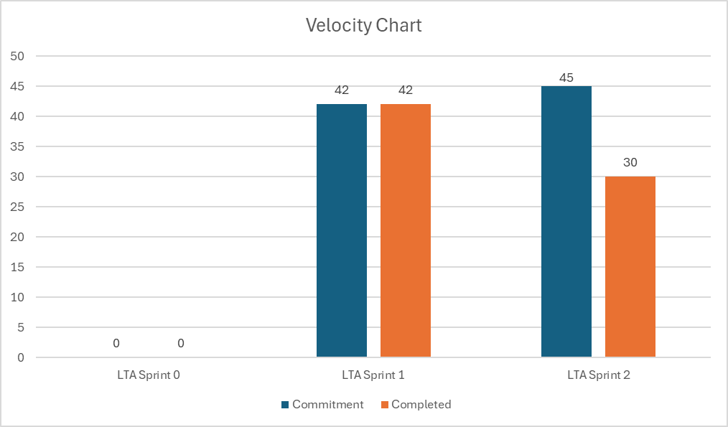
Team Velocity- Sprint 2
Completed/committed Ratio = 30/45 = 66%

Slide 56
Team's Historical Velocity(average)
42 + 30 = 72 / 2
36 points

Slide 57
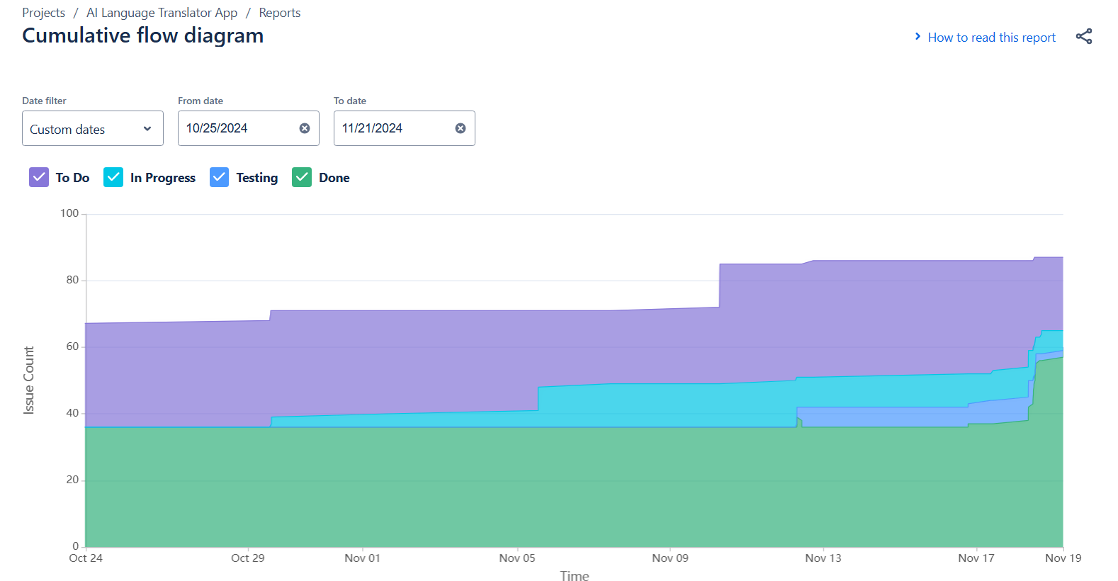
Cummulative flow diagram

Slide 58
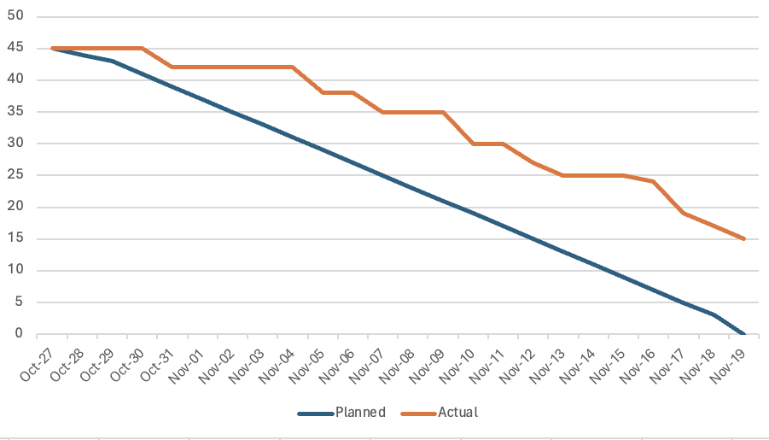
Burndown Chart

Slide 59
Completed / Committed Ratio
Completed = 30
Committed = 45
Completed/committed Ratio = 30/45 = 66%
66%

Slide 60
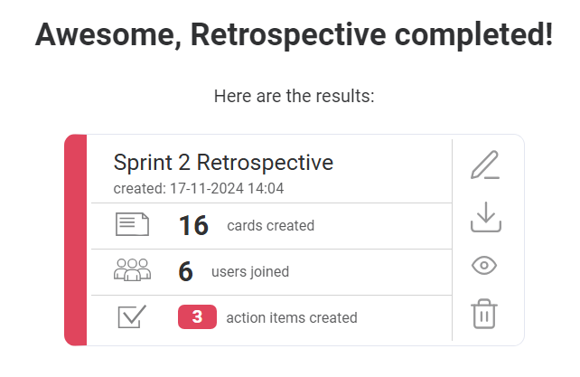
RETROSPECTIVE

Slide 61
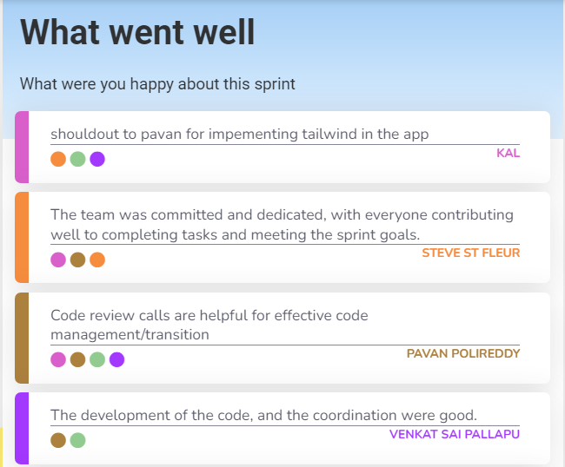
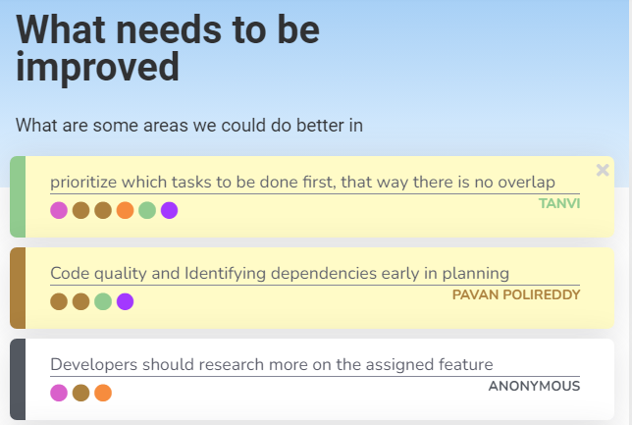
RETROSPECTIVE

Slide 62
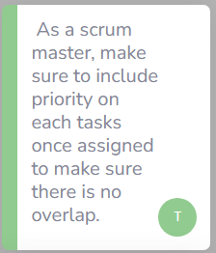
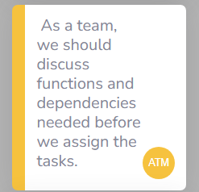
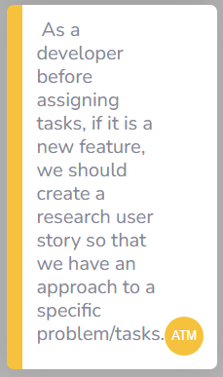
RETROSPECTIVE – Action Item

Slide 63
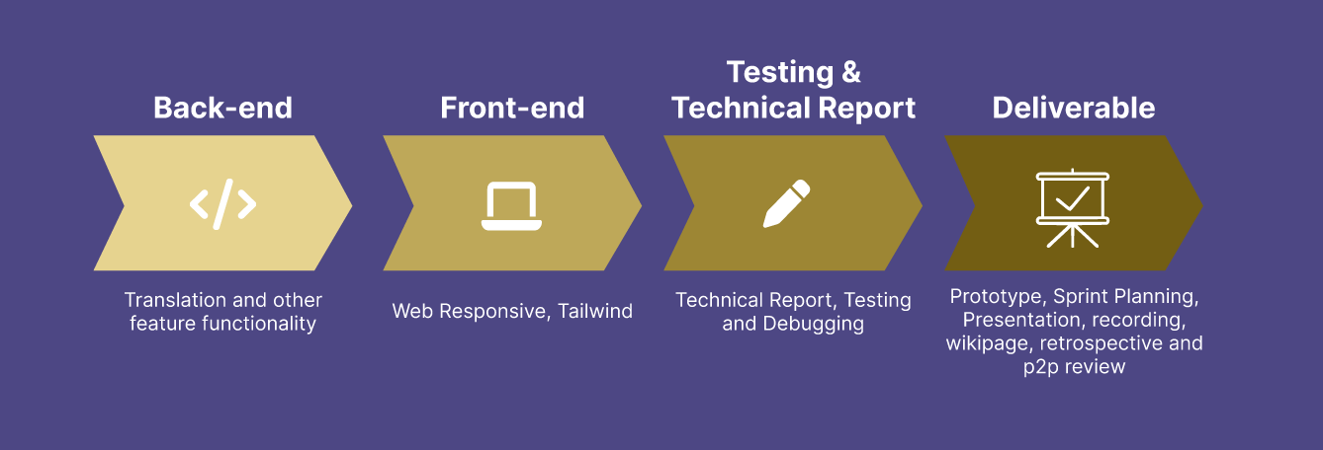
Timeline

Slide 64
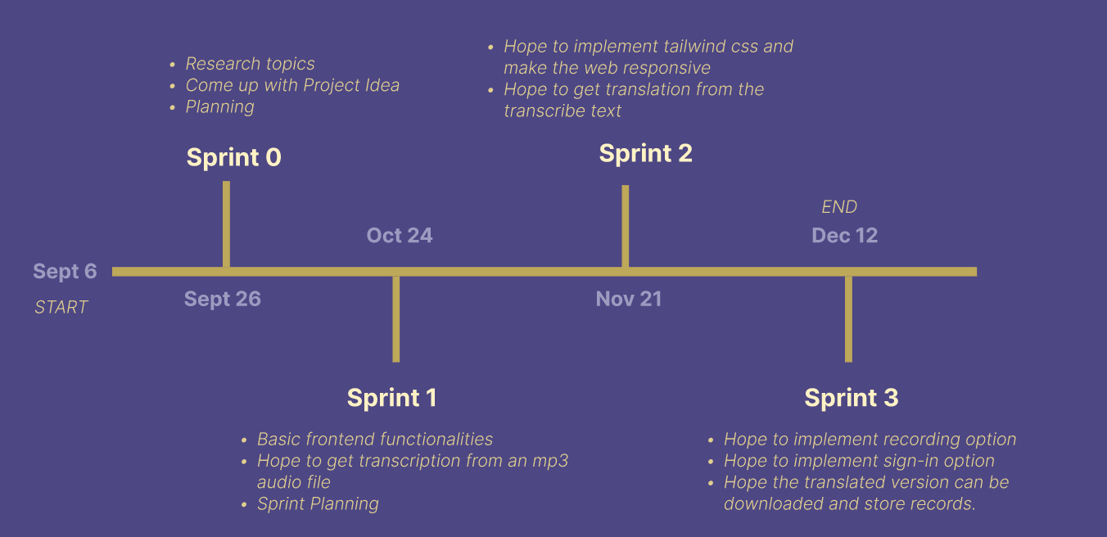
PROJECT SCHEDULE

Slide 65
Sprint 3 User Stories
Key | Feature | Summary | Criteria | Points
LTA-132 | As a student, I want a toggle button to switch between light and dark modes, so that I can change the interface based on my preference. |  |  | 5
 | Toggle Button for Light/Dark Mode | Given I am a student, I want a toggle button to switch between light and dark modes, so that I can change the interface based on my preference. | A toggle button is available to switch between light and dark modes. Clicking the button immediately changes the interface colours according to the selected mode.
LTA-133 | As an elder person, I want my theme preference (light or dark mode) to be saved, so that I can continue using my preferred mode across different sessions without resetting it. |  |  | 3
 | Persisting Theme Preference Across Sessions | Given I am an elderly person, I want my theme preference (light or dark mode) to be saved, so that I can continue using my preferred mode across different sessions without resetting it. | The system remembers the user’s theme preference (light or dark mode) even after the session ends. When the user returns, the interface loads in the previously selected mode.

Slide 66
Sprint 3 User Stories
Key | Feature | Summary | Criteria | Points
LTA-134 | As an editor , I want to mark a translation as a favourite by clicking a star icon, so that I can easily identify and access important translations later. |  |  | 3
 | Marking and Unmarking a Translation as a Favourite | Given I am an editor, I want to mark a translation as a favourite by clicking a star icon, so that I can easily identify and access important translations later. | A favourite (star) icon is displayed at the bottom of each translation. Clicking the star icon marks the translation as a favourite. A visual change (e.g., the star turns solid) occurs when a translation is marked as a favourite. Clicking the star again unmarks the translation as a favourite, and the visual indication reverts.
LTA-135 | As a artist, I want to access my saved favourite translations in a dedicated "Favourites" section, so that I can easily find and reuse my important translations. |  |  | 5
 | Accessing Favourite Translations | Given I am a artist, I want to access my saved favourite translations in a dedicated "Favourites" section, so that I can easily find and reuse my important translations. | Marked favourite translations are saved in a "Favourites" section for easy access. Users can open the "Favourites" section to view and reuse their saved translations. Unmarked translations are removed from the "Favourites" section.

Slide 67
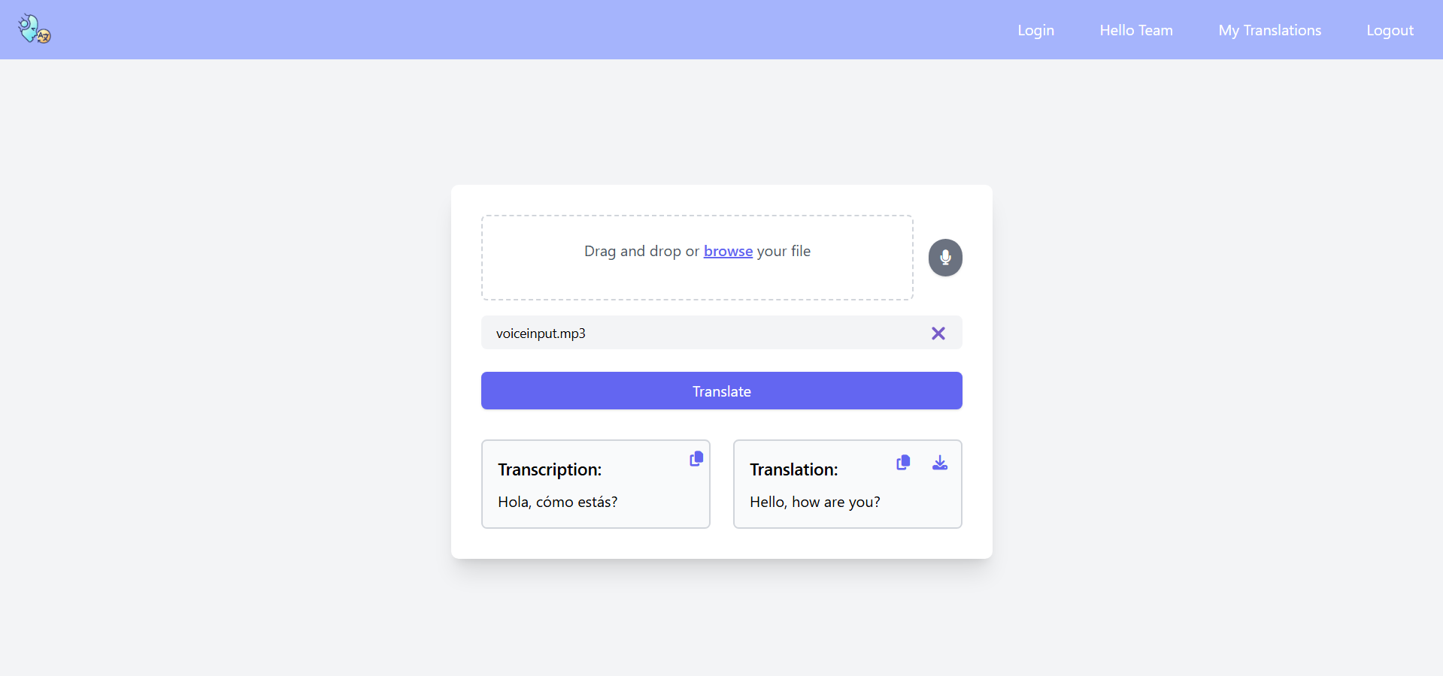
SpeakEZ Screenshot

Slide 68
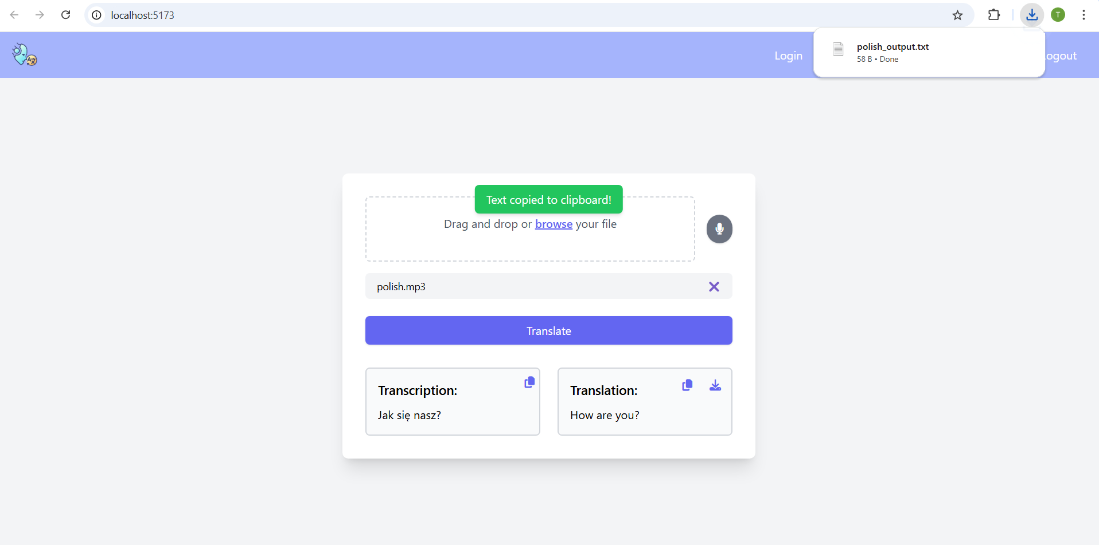
SpeakEZ Screenshot

Slide 69
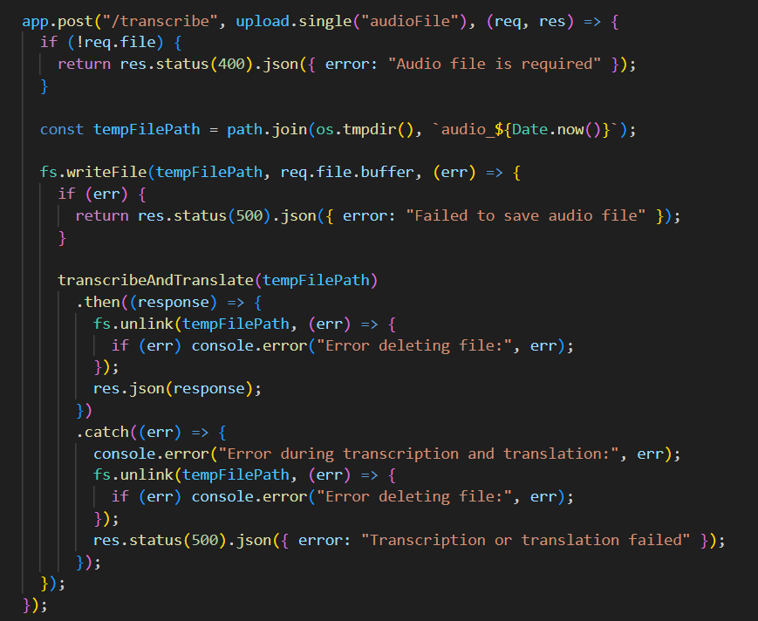
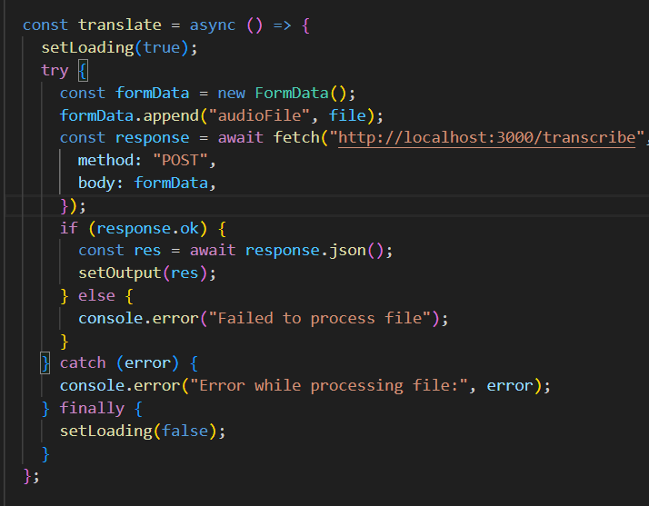
SpeakEZ AI Model Integration

Slide 70
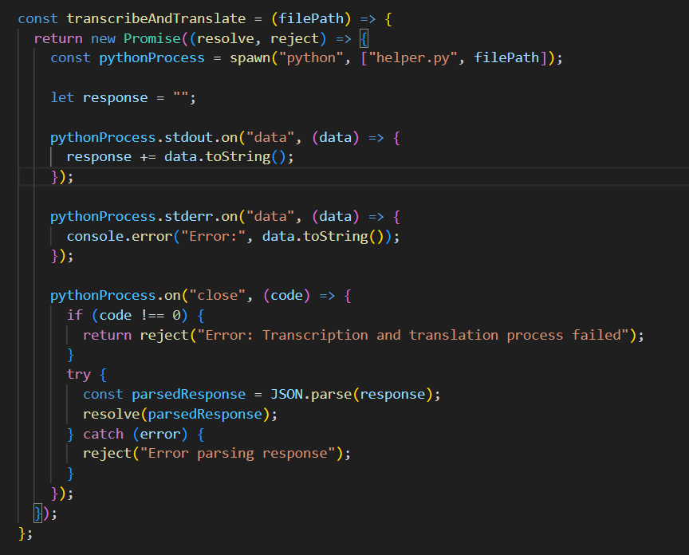
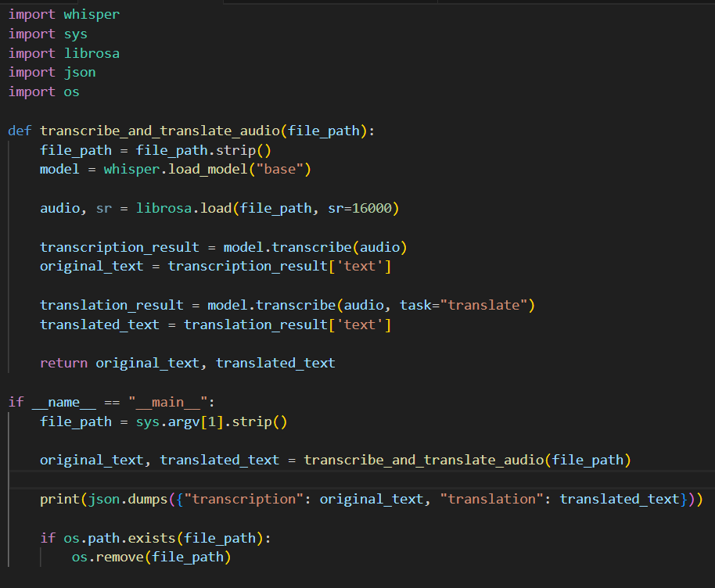
SpeakEZ AI Model Integration

Slide 71
SpeakEZ Demo
Sprint 1 Demo Link
Sprint 2 Demo Link

Slide 72
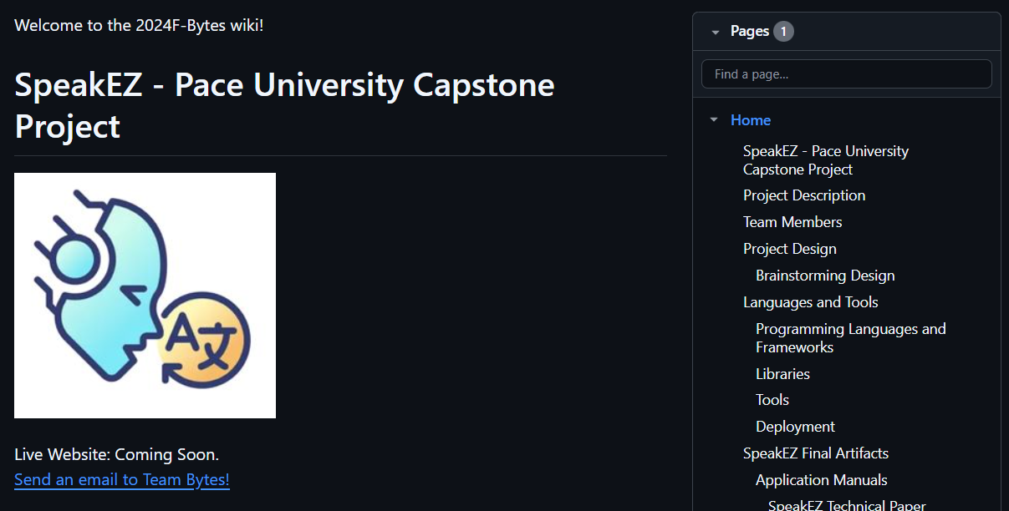
WIKIPAGE LINK
https://github.com/htmw/2024F-Bytes/wiki

Slide 73

THANK YOU!
Do you have any questions?

